Slide 1
Portability of support services for disabled people across Europe
Miro Griffiths, Erasmus+ NA Working Group on Special Needs/Persons with Disability, Berlin, March 2017

Slide 2
Who am I?
Twitter: @mirogriffiths
Worked in disability and rights-based issues for over thirteen years…
Liverpool John Moores University – PhD Researcher and Teacher
European Network on Independent Living – Project/Policy Adviser
Links to British Council and UK Government and civil society organisations
Particular interests in disablement, political ideology, social movements and activism

Slide 3
What will we discuss?
Legislative Statements
Problems with portability
Opportunities
Questions

Slide 4
Government and Society’s Beliefs & Attitudes Historically
Dependent, uneducable, unemployable and unproductive, therefore in need of care, sheltered employment and welfare.
Patients who are incurable.
Not people with equal rights.
Need to be segregated.
This does not accuse non-disabled people as conscious oppressors who seek to actively persecute disabled people – it is a reflection of the continual oppression happening systematically and through brief, daily occurrences.

Slide 5
Disabled people’s life experiences…
…have been subject to other peoples’ behaviours, meaning their perception of disabled people results in actions (usually negative ones):
Institutionalisation
Community Care
Sheltered Employment
Sterilisation
Screening in pregnancy
Genetic engineering
Euthanasia

Slide 6
UNCRPD
Articles:
18 - Liberty of movement and nationality
States Parties shall recognize the rights of persons with disabilities to liberty of movement, to freedom to choose their residence and to a nationality, on an equal basis with others…
19 - Living independently and being included in the community
States Parties to this Convention recognize the equal right of all persons with disabilities to live in the community, with choices equal to others, and shall take effective and appropriate measures to facilitate full enjoyment by persons with disabilities of this right and their full inclusion and participation in the community…
24 – Education
States Parties recognize the right of persons with disabilities to education. With a view to realizing this right without discrimination and on the basis of equal opportunity…
2.(c) Reasonable accommodation of the individual's requirements is provided; (d) Persons with disabilities receive the support required, within the general education system, to facilitate their effective education;

Slide 7
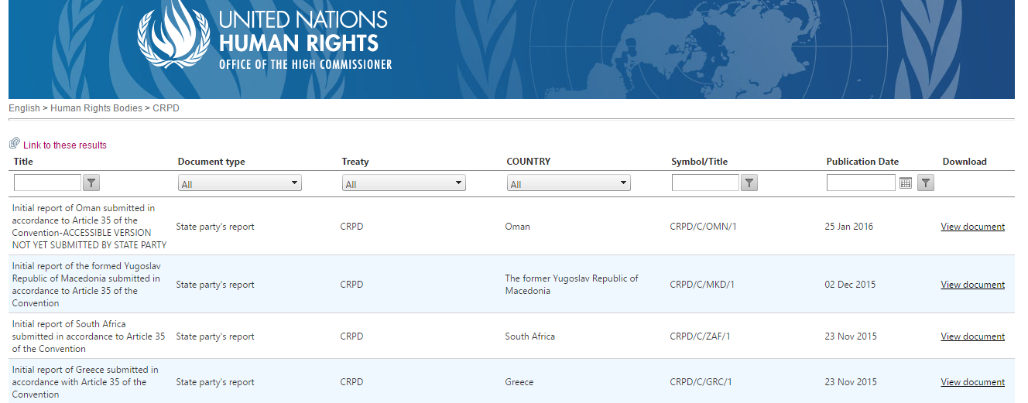
UNCRPD – State Reponses/Reports
http://tbinternet.ohchr.org/_layouts/treatybodyexternal/TBSearch.aspx?Lang=en&TreatyID=4&DocTypeID=29

Slide 8
UNCRPD – List of Issues (and Replies)
List of Issues -http://tbinternet.ohchr.org/_layouts/treatybodyexternal/TBSearch.aspx?Lang=en&TreatyID=4&DocTypeID=18
Replies to Issues -http://tbinternet.ohchr.org/_layouts/treatybodyexternal/TBSearch.aspx?Lang=en&TreatyID=4&DocTypeID=22
Example - What measures is the European Union taking in particular to ensure that persons with disabilities can transfer their social protection, disability and personal assistance benefits to another member State in order to exercise their freedom of movement?

Slide 9
UNCRPD - Responses
Member States usually do not highlight or declare measures to address portability…
EU (2015):
Response states the social security protection of disabled people is assured by Member States, under national law. EU law does not harmonise national social security systems, but coordinates them with regard to insured persons in cross-border situations.
Exportability of benefits only refer to ‘invalidity pensions’
Social assistance benefits are provided by Member States according to their national legislation and cannot be transferred to another Member State if the beneficiary changes residence. Directive 2004/38/EC enables Member States to limit the right to social assistance under certain conditions.

Slide 10
UNCRPD - General Comment No 4 (2016) Article 24
Barriers that impede access to inclusive education for persons with disabilities can be attributed to multiple factors…but did not reference portability of support packages
Whole person approach is locked to geographical borders
‘every person to learn, and high expectations are established for all learners…system must provide a personalized educational response, rather than expecting the student to fit the system.’
‘All members of the learning community are welcomed equally, with respect for diversity according to, inter alia, disability, race, colour, sex, language, linguistic culture, religion, political or other opinion, national, ethnic, indigenous or social origin, property, birth, age or other status.’
Adaptability - the Committee encourages States parties to apply the Universal Design for Learning (UDL) approach…missing pressure to highlight imported support needs?

Slide 11
European Commission
Progress Report on the implementation of the European Disability Strategy (2010-2020)
Promote dialogue among Member States in the Disability High Level Group on the portability of rights such as the right to personal assistance
Ensure that disability-specific issues are covered in any revisions of legislation concerning pensions and benefits portability
The Committee recommends that the European Union take immediate action to ensure that all disabled people and their families can enjoy their right to freedom of movement on an equal basis with others, including with regard to the portability of social security benefits, in a coordinated manner across its member States
Introduce the EU Disability Card and the system of associated benefits in their countries
Education specific?
Disability-related indicators linked to the Europe 2020 targets for education, employment and poverty reduction have been developed showing the gap with the rest of the population.

Slide 12
What Problems Exist?
There are countries that do not possess any legislation for personal support…some utilise institutionalisation
Does not reflect the philosophy of the Disabled People’s Movement, ultimately leading to terms and definitions being hijacked and voice silenced. This means that there is a general lack of political engagement on this specific issue, with no clear direction being offered…
Research shows that DPOs have struggled to advise appropriate bodies and when they have had opportunities to share their views and recommendations, their guidance has been omitted by the time the proposals have become public…
where drafted laws have been prepared or implemented, there is an assumption that States will not adopt the proposals or will seek to dismantle the established, existing support schemes
There are States that promote a self-directed approach to using support but there are others which restrict all decision-making over how and when to use the support package.

Slide 13
The Impairment Focus
The process to identify if a person ‘should’ receive support can be impairment specific…
Rather than perceive exclusion by acknowledging the various barriers which disable and restrict all from being valued members of society, the focus on ‘qualifying’ impairments groups means we undoubtedly create a hierarchy – further marginalising pockets within the disabled people’s community…
Will also be impacted by low expectations/fluctuating conditions associated with certain cohorts – i.e. learning disability and mental health
States are selectively removing people with particular access or support needs from the eligibility criteria of their established support
The vision of portable support packages becoming a viable option for disabled people will be limited to countries which ‘acknowledge’ the disabling barriers affecting all disabled people

Slide 14
Assessment Process Implications
The assessment criteria has not been developed into a standardised, universal tool;
The barriers that disabled people experience can be thematic and should be considered a global issue but the methods for assessing need is dependent upon a country’s established support framework and the interpretation of the funder (whether that is local government authority or the state);
We should not underestimate the dangers of having an interpretative approach to identifying support as the current methods allow for excessive reliance on medicalised assessment tools – e.g. ‘bio-psycho-social model’, it makes it difficult to challenge decisions over support and leaves disabled people with no equal basis or reassurance when moving between Member States;
Factor of hourly rates paid to support staff as well as assessments deciding that support budgets should be capped at a specific number of hours.

Slide 15
Opportunities

Slide 16
Opportunities Continued
Liaise with State Members to discuss ‘portability’ in State Reports
Identify members who coordinate/write Shadow Reports for UNCRPD
Create dialogue with Special Rapporteur on the ‘Rights of Persons with Disabilities’, Ms. Catalina Devandas Aguilar
Respond to next set of ‘List of Issues’, particularly if it addresses countries associated with the Working Group
Promote agenda item to Disability Intergroup in European Parliament
Highlight issues with national and international student unions, particularly groups run by disabled students; disabled people’s organisations; inclusive education organisations, such as Alliance for Inclusive Education; National Equality Commission(s); Academic Network of European Disability Experts (ANED)

Slide 17
Let’s Keep Talking…
Miro Griffiths
Email: m.griffiths2@ljmu.ac.uk
Twitter: @mirogriffiths
Mobile: 07835 413 238
https://ljmu.academia.edu/MiroGriffiths
Please contact me for references cited during presentation

