Slide 1
Erasmus+ Working Group on Special Needs/Persons with Disability – a German perspective
Berlin, 23 March 2017
Christina Roll, NA DAAD

Slide 2
Welcome to Berlin!

Slide 3
Erasmus+ National Agency „Higher Education“ at DAAD (German Academic Exchange Service)
Key Action 1 : Mobility of Individuals
KA103: Mobility within Programme Countries
Student Mobility for Studies (SMS)
Student Mobility for Placement (SMP)
Staff Mobility for Teaching Assignments (STA)
Staff Mobility for Training (STT)
KA107: Mobility between Programme and Partner Countries

Slide 4
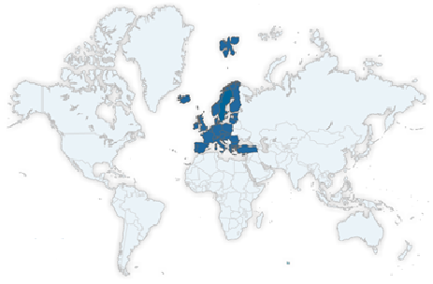
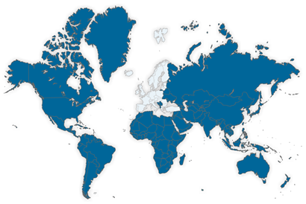
Programme Countries (KA103)
Partner Countries (KA107)

Slide 5
Funding for Students/Staff with Special Needs
Lump sum for students with children (SMS)
Monthly grant for students with disabilities (SMS/SMP)
Individual application for students/ staff with disabilities (up to 10.000 EUR) (SMS/SMP/STA/STT)

Slide 6
Funding for Students/Staff with Special Needs
Requirements:
Students/Staff have already been chosen for the Erasmus+ programme
HEI is in possesion of an ECHE and takes part in the Erasmus+ programme
Inter-Institutional Agreement (IIA) between sending and receiving instituion
Identity card of the disabled: degree of disability of at least 50

Slide 7
Funding for Students/Staff with Special Needs
Requirements:
Identity card of the disabled: degree of disability of at least 50
What criteria do other NAs use?
How can we develop soft factors?
Would a „wording pool“ help?
Is a medical certificate sufficient? What would the requirements be?

Slide 8
Lump sum for students with children (SMS)
Example
Student with 1 child
Student mobility for studies for 5 months in Italy
200 EUR lump sum/ month x 5 months = 1.000 EUR additional grant by NA DAAD

Slide 9
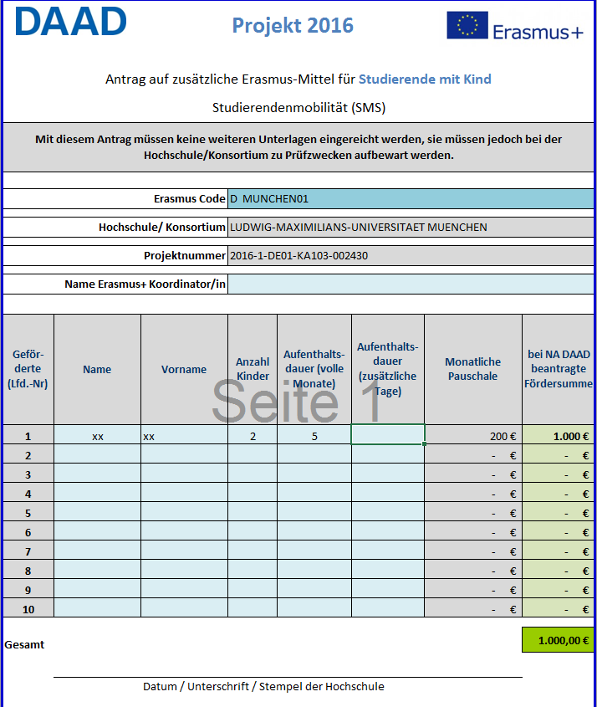

Slide 10
Monthly grant for students with disabilities (SMS/SMP)
Example
Student mobility for studies for 5 months in Italy (Country Group 1: 250 to 500 EUR/ month)
Funding given by HEI to all students: 300 EUR/ month
200 EUR difference x 5 months = 1.000 EUR additional grant by NA DAAD

Slide 11
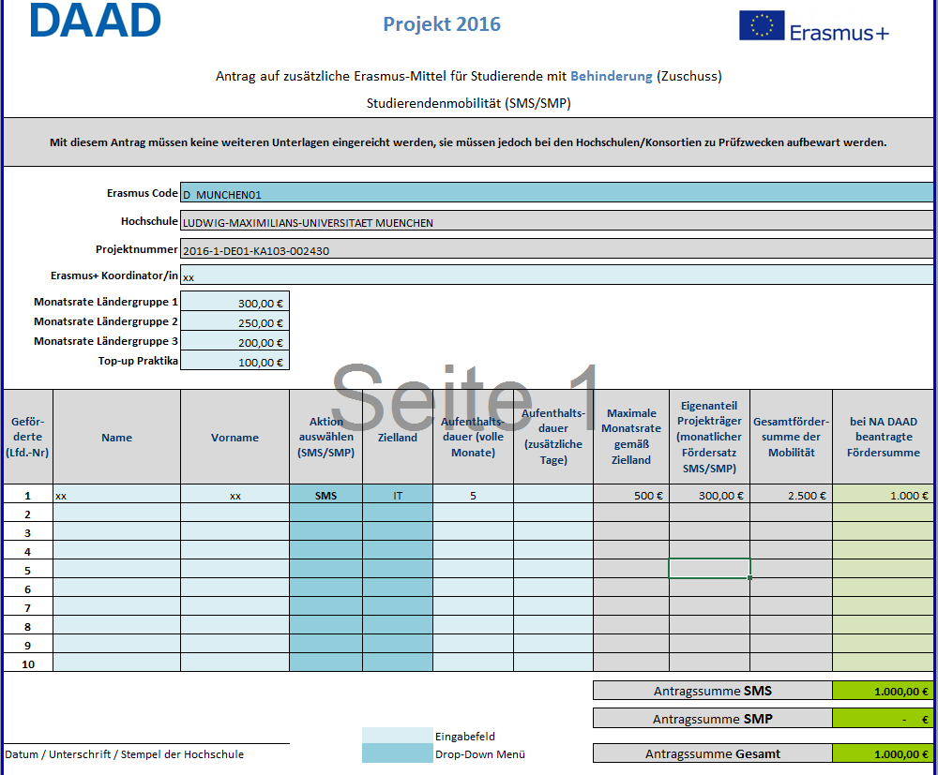

Slide 12
Individual application for students/staff with disability (SMS/SMP/STA/STT)
Application should be submitted 2 months before the start of mobility
Backdated funding is not possible
Only expenses incurred by/during the mobility can be covered
Annexes:
Copy of the identity card of the disabled
Proofs of approximate costs (e.g. flight costs for accompanying persons, higher costs for barrier-free housing)

Slide 13
Individual application for students/staff with disability (SMS/SMP/STA/STT)
Example
Application of a student (wheelchair user) for a 4-months-stay in London
Flight Düsseldorf – London (round trip): 200 EUR
(proved by annexes)
Distance based flatrate: Düsseldorf – Calais and Dover – London (round trip)
520 km + 520 km x 0,20 EUR = 208 EU
(proved by annexes)
Ferry Calais-Dover (round trip) : 240 EUR
(proved by annexes)

Slide 15
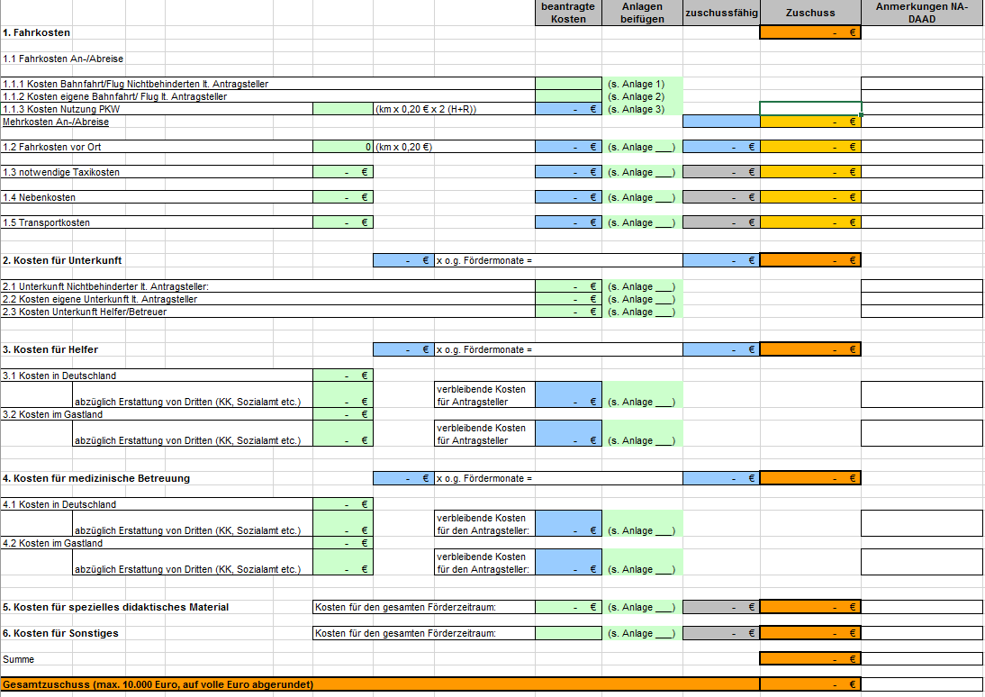

Slide 16
Special Needs (Project 2015)
Monthly grant for students with disabilites
Lump sum for students with child/children
Project 2015
Project 2015
65 Students
76.574 EUR
22 students
24.262 EUR

Slide 17
Special Needs (Project 2015)
Individual Application for students and staff with disability
Project 2014
23.400 EUR 5 Outgoing
Project 2015
54.500 EUR 10 Outgoing
8.600 EUR 2 Incoming
Project 2016
46.080 EUR 6 Outgoing

Slide 18
Individual Application for Students with disabilities
Project 2015: 01.06.2015 – 31.05.2017
Student mobility for studies
Radboud Universiteit Nijmegen, Netherlands
University College Cork, Ireland
University of Prague, Czech Republic
Technical University Tallinn, Estonia
Ege Universität Izmir, Turkey
Europa Universität Viadrina Frankfurt/Oder, Germany

Slide 19
Nationale Agentur für EU-Hochschulzusammenarbeit Erasmus+ National Agency „Higher Education“ DAAD – Deutscher Akademischer Austauschdienst German Academic Exchange Service (DAAD) Kennedyallee 50 53175 Bonn www.daad.de www.eu.daad.de Servicenummer: 0800 2014 020

