Slide 1
KA2 Strategic Partnerships for HE on the topic
of Disabilities and special needs
23-03-2017
Irma Vyšniauskienė

Slide 2
Sources of information:
list of projects received from Mr. Luca Pirozzi, EC (for the year 2014 and 2015)
Erasmus+ Project results platform: http://ec.europa.eu/programmes/erasmus-plus/projects/
projects’ websites (if any)
Notes:
Lietuvos aukštųjų mokyklų atstovai: studentai, dėstytojai, darbuotojai

Slide 3
16 SPs for HE on the topic of
Disabilities and special needs have been funded
Out of 155 contracted for HE,
≈ 5 %
Out of 159 contracted for HE,
≈ 4 %
Notes:
Lietuvos aukštųjų mokyklų atstovai: studentai, dėstytojai, darbuotojai

Slide 4
Projects which could be interesting for
our WG as well as for HEIs:
MappED!
MobiAbility: A European standard on support measures in the EHEA for international students with disabilities
Inclusive networking campus to foster the access to university of young students with disabilities
Innovation and social learning in HEI
Notes:
Lietuvos aukštųjų mokyklų atstovai: studentai, dėstytojai, darbuotojai

Slide 5
2. MobiAbility: A European standard on support measures in the EHEA for international students with disabilities (I)
No. 2016-1-ES01-KA203-025001
Duration: 3 years (01-09-2016 – 31-08-2019)
EC Grant: 168,315 EUR
Coordinator: Universidad de Murcia (Spain)
6 partners: Spain (3), Poland (1), Czech Republic (1), Romania (1) 4 of consortium members are universities, 3 other organizations leaders in the national and international field of defence and exercise of the rights of persons with disabilities.
Notes:
Lietuvos aukštųjų mokyklų atstovai: studentai, dėstytojai, darbuotojai

Slide 6
MobiAbility: A European standard on support measures in the EHEA for international students with disabilities (II)
Context: one of the areas less standardized in the lives of people with disabilities is international mobility in general and, in particular, international mobility during university studies, despite the reinforcement of active policies in this field. Experts agree that one of the main reasons of the low rate of European mobility of persons with disabilities is the lack of a common position or standard on key curricular adaptations to be performed that should be accepted by the participating countries. These should be assumed as measures of accessibility and reasonable adjustments which have to be guaranteed in order to promote equal opportunities for any student with disabilities interested in international mobility. This project aims to advance and innovate in this aspect.
Notes:
Lietuvos aukštųjų mokyklų atstovai: studentai, dėstytojai, darbuotojai

Slide 7
MobiAbility: A European standard on support measures in the EHEA for international students with disabilities (III)
Expected results:
a European transnational standard of measures and reasonable adjustments at academic level for students with disabilities in international mobility will be developed;
a protocol for efficient transnational communication between the specialized units of universities will be proposed;
an online and multilingual platform that hosts a catalogue of institutions reaching this standard will be developed.
Suggestion: more information about this project is needed, e.g. project timetable which could illustrate what kind of activities (Intellectual outputs, LTT activities (if any), Multiplier events, etc.), where and when are going to be finalised or organised.
Notes:
Lietuvos aukštųjų mokyklų atstovai: studentai, dėstytojai, darbuotojai

Slide 8
3. Inclusive networking campus to foster the access to university of young students with disabilities (I)
No. 2015-1-ES01-KA203-016095
Duration: 3 years (01-09-2015 – 31-08-2018)
EC Grant: 315,100 EUR
Coordinator: Fundacion Once para la Cooperacion e Inclusion Social de Personas con Discapacidad (Spain)
3 partners: Belgium (1), Portugal (1), Spain (1)
Notes:
Lietuvos aukštųjų mokyklų atstovai: studentai, dėstytojai, darbuotojai

Slide 9
Inclusive networking campus to foster the access to university of young students with disabilities (II)
The main objective: to encourage and help students with disabilities in second cycle of secondary school and high school to continue their education towards university, since this group is in high risk of early school leaving, which involves a greater likelihood of experiencing social exclusion in adulthood.
Specific objectives:
Promote transnational mobility of young persons with disabilities.
Promote access to college for students with disabilities, reducing early school dropout in this group.
Give universities the opportunity to reach future potential university students and identify opportunities for improvement in their campus, so that they are prepared to offer an inclusive university education under conditions of equal opportunities for all the students.
Improve and promote the inclusion of persons with disabilities in the university community.
Notes:
Lietuvos aukštųjų mokyklų atstovai: studentai, dėstytojai, darbuotojai

Slide 10
Inclusive networking campus to foster the access to university of young students with disabilities (III)
Main activities. 6 Different inclusive campuses will be organised:
3 pilot inclusive campuses in Lisbon, Granada and Antwerp (July, 2016) and
3 consolidated campuses in the same cities (July, 2017).
For each campus, previously recruited young students with disabilities (local and foreign) from pre-university education (aged 16-18) and a group of volunteers, will enjoy a 7-day stay in an university campus where they will learn at first-hand what a normal day is like for a university student, and will take part in academic, cultural and leisure activities. They will also be offered different activities to identify the talent and their future professional skills, as well as to improve their language and social skills.
Notes:
Lietuvos aukštųjų mokyklų atstovai: studentai, dėstytojai, darbuotojai

Slide 11
Inclusive networking campus to foster the access to university of young students with disabilities (IV)
Expected results:
Encourage the continuity to HE of students with disabilities, whose level of dropout during the high school is very high.
Encourage the participation of those students in students’ mobility programmes.
Identify improvement opportunities aimed at developing protocols for students with disabilities in the university environment.
Suggestion: from the project description it was not clear what intellectual outputs are going to be created. Therefore, it would be interesting to receive a list of intellectual outputs as well as project timetable which could illustrate what kind of activities (LTT activities, Multiplier events, etc.), where and when are going to be organised.
Notes:
Lietuvos aukštųjų mokyklų atstovai: studentai, dėstytojai, darbuotojai

Slide 12
4. Innovation and social learning in HEI (I)
No. 2014-1-PT01-KA203-001087
Duration: 2 years (01-10-2014 – 30-09-2016)
EC Grant: 201,951 EUR
Coordinator: Universidade Aberta (Portugal)
7 partners: Italy (2), Slovenia (1), Sweden (1), Portugal (3)
Notes:
Lietuvos aukštųjų mokyklų atstovai: studentai, dėstytojai, darbuotojai

Slide 13
Innovation and social learning in HEI (II)
Considering the concrete needs of the hearing-impaired and visually-impaired groups for accessing HEI programmes, the project brings some important innovations translated into the main outputs foreseen:
A handbook showing the methods and procedures to be used for developing and delivering ICT based learning valid also for mentioned target group (not specially done for them, but designed in such a way that correspond also to their specific needs).
The ISOLearn Quality Label will establish quality standards and assessment procedures and instruments to be used for evaluating whether HEI education and training programmes correspond to the ISOLearn standards regarding the accessibility of these groups to their learning offer.
Notes:
Lietuvos aukštųjų mokyklų atstovai: studentai, dėstytojai, darbuotojai

Slide 14
Innovation and social learning in HEI (III)
Main expected impact:
To facilitate, at a national level, the adequate development of HE courses in order to better serve visual and hearing-impaired persons.
To promote the exchange of good practices and the level of quality, among different European countries on the pedagogical methodologies to use on HE courses offered to visual and hearing-impaired persons.
To promote virtual and/or physical mobility of visual and hearing-impaired persons within the European higher education system.
Suggestion: the project ended last year but the results are not yet published on Erasmus+ Project results platform. When the results will be available, it would be interesting to look through the main outputs of the project and in particular to find information about the promotion of virtual and (or) physical mobility for visual and hearing-impaired persons.
Notes:
Lietuvos aukštųjų mokyklų atstovai: studentai, dėstytojai, darbuotojai

Slide 15
Project which could be interesting to institutions, responsible for the development of national strategies aiming to increase the access of disadvantage groups in HE as well as for HEIs:
UNIALL – Accessibility of Higher Education for Students with Special Needs
No. 2015-1-SK01-KA203-008959
Duration: 3 years (01-09-2015 – 30-06-2018)
EC Grant: 245,900 EUR
Coordinator: Slovenska Technicka Univerzita v Bratislave (Slovakia)
3 partners: Italy (1), Czech Republic (2)
Notes:
Lietuvos aukštųjų mokyklų atstovai: studentai, dėstytojai, darbuotojai

Slide 16
UNIALL – Accessibility of Higher Education for Students with Special Needs (II)
The objective: systematic development, testing, and examination of effective inclusive methodology to ensure access for under-represented groups in HE, in particular through student-centered learning and by providing relevant support, guidance and counselling.
Expected results:
development of common framework for national strategies and action plans with aim to increase the access, participation and completion rates of disadvantaged groups in HE. The project results and outputs will be used for effective mapping and evaluation of overall accessibility of HE by Access Audits Tool.
tools for improvement of the support services for students with special needs in HE, including access to information (university websites, AIS system, Virtual guide) will be created.
Notes:
Lietuvos aukštųjų mokyklų atstovai: studentai, dėstytojai, darbuotojai

Slide 17
UNIALL – Accessibility of Higher Education for Students with Special Needs (III)
Expected results:
the publication of case studies of inclusive higher education in Europe as collection of examples of the best practices that can help other universities to make accessibility improvements will be prepared. The overall methodology for creation of accessible HE will be elaborated as “Handbook on Universal Accessibility of Higher Education“ that can be used at various European universities.
Suggestion: this project might be very interesting and useful to: institutions, responsible for the development of national strategies aiming to increase the access of disadvantage groups in HE; institutions responsible for the implementation of the Bologna process; HEIs, willing to improve the support services to students with special needs.
Notes:
Lietuvos aukštųjų mokyklų atstovai: studentai, dėstytojai, darbuotojai

Slide 18
Projects, which might be interesting for HEIs in general:
MOOC Accessibility Partnership
Universal Design in Higher Education – Licence to Learn
Notes:
Lietuvos aukštųjų mokyklų atstovai: studentai, dėstytojai, darbuotojai

Slide 19
1. MOOC Accessibility Partnership (I)
No. 2014-1-DE01-KA203-000679
Duration: 3 years (01-09-2014 – 31-08-2017)
EC Grant: 441,583 EUR
Coordinator: Hochschule der Medien (Germany)
8 partners: Norway (1), United Kingdom (2), Ireland (1), Greece (1), France (1), Austria (1), Germany (1)
Website: http://www.gpii.eu/moocap
The goal: to provide education on accessible design in ICT. Free online courses are created that teach how to create accessible media and content, such as web sites, mobile apps and office documents.
Notes:
Lietuvos aukštųjų mokyklų atstovai: studentai, dėstytojai, darbuotojai

Slide 20
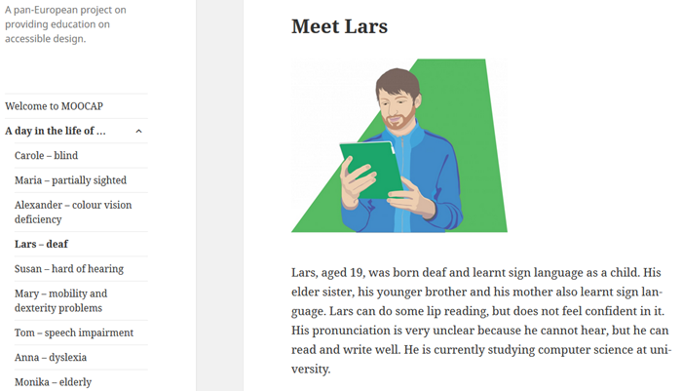
MOOC Accessibility Partnership (II)
Results, which could be interesting:
• Day-in-the-life stories of 9 persons, facing different types of disabilities or having other special needs. These stories can be used to help designers and developers think about questions related to the development of ICT products and electronic documents.
Notes:
Lietuvos aukštųjų mokyklų atstovai: studentai, dėstytojai, darbuotojai

Slide 21
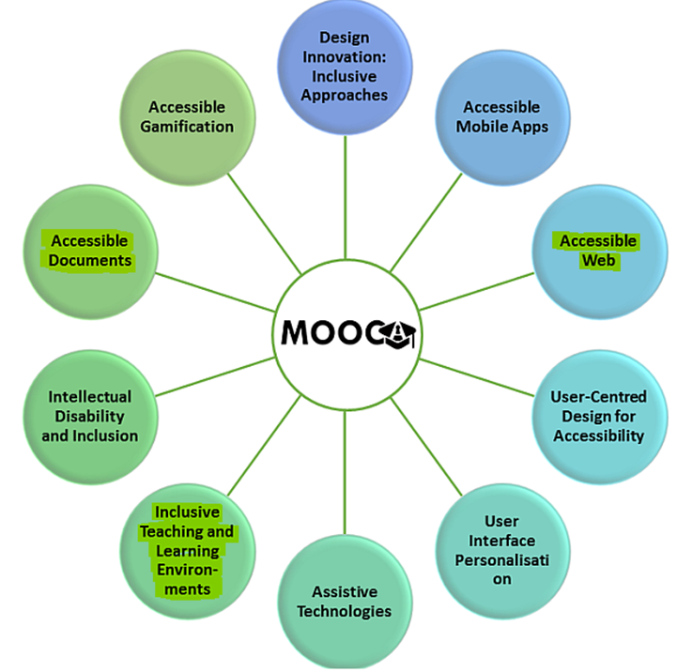
MOOC Accessibility Partnership (III)
Results, which could be interesting:
• 10 courses which can help to learn about how to design products and systems for daily living in order to make them accessible to, understandable by and usable for a wide range of people.
Notes:
Lietuvos aukštųjų mokyklų atstovai: studentai, dėstytojai, darbuotojai

Slide 22
2. Universal Design in Higher Education –
Licence to Learn (I)
No. 2014-1-NO01-KA203-000426
Duration: 2 years (01-11-2014 – 31-10-2016)
EC Grant: 138,000 EUR
Coordinator: Norges Teknisk-Naturvitenskapelige Universitet NTNU (Norway)
2 partners: Ireland (1), Belgium (1)
Website: http://www.udll.eu
Main purpose: to examine how all students can get equal opportunities to learn using more flexible methods of teaching, assessment and service provision to cater for different styles of learners.
Notes:
Lietuvos aukštųjų mokyklų atstovai: studentai, dėstytojai, darbuotojai

Slide 23
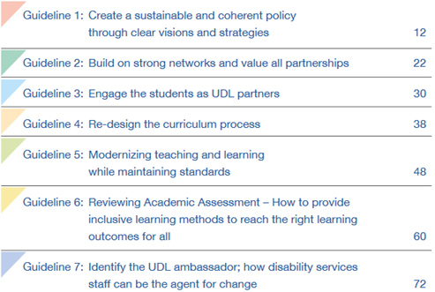
Universal Design in Higher Education –
Licence to Learn (II)
Results, which could be interesting:
A best practice guideline for implementing Universal Design for Learning in HE.
Notes:
Lietuvos aukštųjų mokyklų atstovai: studentai, dėstytojai, darbuotojai

Slide 24
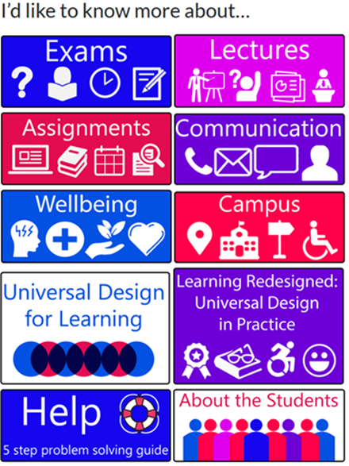
Universal Design in Higher Education –
Licence to Learn (III)
Results, which could be interesting:
A toolkit for the students to address
challenges they meet in their
learning environment.
Notes:
Lietuvos aukštųjų mokyklų atstovai: studentai, dėstytojai, darbuotojai

Slide 25
Projects, which might be interesting for HEIs, offering such study programs as education, nursing, social work, social education, teaching, psychology, sign language, healthcare:
An interdisciplinary approach to working with children and young people with complex intellectual and developmental needs.
Inclusive Education in Early Childhood: Developing Good Practices
Additional training Special Education
Enhancing communication: research to improve communication for people with special needs and development of TIC resources and tools.
Notes:
Lietuvos aukštųjų mokyklų atstovai: studentai, dėstytojai, darbuotojai

Slide 26
An interdisciplinary approach to working with
children and young people with complex intellectual
and developmental needs
No. 2014-1-SE01-KA203-001023
Duration: 3 years (01-09-2014 – 31-08-2017)
EC Grant: 217,555 EUR
Coordinator: Stockholms Universitet (Sweden)
4 partners: United Kingdom (2), Romania (1), Norway (1)
Main aim: to develop a shared on-line learning module focusing on the policy, research and best practice in meeting the education, health and social work needs of children and young people with complex intellectual and developmental disabilities.
Notes:
Lietuvos aukštųjų mokyklų atstovai: studentai, dėstytojai, darbuotojai

Slide 27
Inclusive Education in Early Childhood:
Developing Good Practices
No. 2014-1-TR01-KA203-011754
Duration: 3 years (01-09-2014 – 31-08-2017)
EC Grant: 355,915 EUR
Coordinator: Balikesir University (Turkey)
6 partners: Belgium (1), Netherlands (1), Lithuania (1), United Kingdom (1), Portugal (1), Denmark (1)
Main goals:
to produce a manual with the models of inclusive education of the different participating countries and
create a transnational model with all the best components together in the languages of participating countries to be used in teacher preparation for the development of competencies and talents of children in inclusive classrooms. This model will be illustrated with ‘good practices’ from different countries as case studies and supported by examples of activities developed by experts of the different countries in different disciplines.
Notes:
Lietuvos aukštųjų mokyklų atstovai: studentai, dėstytojai, darbuotojai

Slide 28
3. Additional training Special Education
(Zusatzausbildung Förderpädagogik)
No. 2015-1-BE03-KA203-001597
Duration: 2 years (01-09-2015 – 31-08-2017)
EC Grant: 72,959 EUR
Coordinator: Autonome Hochschule in der Deutschsprachigen Gemeinschaft (Belgium)
2 partners: Germany (1), Luxembourg (1)
Context:
In Belgium and Luxembourg, there is no specific teacher training to teach pupils with special needs in the regular schools and in the special schools: much of the work is done by "learning in the job" or by further education.
In Germany, teacher training for regular schools differs a lot from the training for special schools. So, a new form had to be found for young teachers with a bachelor grade and working either in special schools or in settings of integration for pupils with special needs in regular schools. After their bachelor grade, they get the possibility to enroll for a certificate of advanced studies (15 credit points) providing them the basics of special education. During this CAS, the participants will acquire new skills and knowledge based on the vocabulary of the international classification of functioning disability and health (ICF), a concept well-known in special education in different countries of Europe.
Notes:
Lietuvos aukštųjų mokyklų atstovai: studentai, dėstytojai, darbuotojai

Slide 29
4. Enhancing communication: research to improve
communication for people with special needs and
development of TIC resources and tools
No. 2015-1-ES01-KA203-015625
Duration: 2 years, 2 months (01-10-2015 – 31-12-2017)
EC Grant: 112,265 EUR
Coordinator: University of Malaga (Spain)
3 partners: Austria (1), Belgium (1), Spain (1)
Website: http://sites.google.com/site/ecplusproject/
Project aims at training students from several disciplines (education, psychology, interpreting and speech therapy) in specialized communication with disabled and developing a comprehensive framework of IT tools to enhance communication with people who are at high risk of total exclusion due to severe intellectual disability.
The target groups are university students who will be future professionals (teachers, speech therapists, psychologists, sign language interpreters, community interpreters).
Notes:
Lietuvos aukštųjų mokyklų atstovai: studentai, dėstytojai, darbuotojai

Slide 30
Thank you :)
Email irma.vysniauskiene@smpf.lt
Phone: +370 5 250 3709

