Slide 1
Erasmus+
International credit mobility
European Commission
Directorate-General for Education & Culture
Notes:
This is a presentation linked to the 2020 call for proposals
Be sure to read the "what's new in ICM in 2020" document – or have it with you!

Slide 2
Notes:
2
Show of hands
Who is familiar with the Erasmus programme? Erasmus+?
Who is already working with European partners in the framework of the Erasmus+ programme? ICM? Other?
Erasmus EU's higher education programme, celebrating 32 years.
Erasmus+ is the EU's programme for education, training, youth and sport starting in 2014 and running until 2020.
With a budget of over 1.7 billion euros earmarked for cooperation with third countries, it's our most international programme yet.
For those who are new to Erasmus+, the way the programme works is that participating countries are divided into two groups: Programme and Partner Countries.
34 Programme Countries (EU 28 + 6) contribute financially to the programme and have a National Agency to manage it. The latest member to join is Serbia (2019).

Slide 3
Notes:
3
Partner Countries are all other countries throughout the world, who also benefit from our programmes.

Slide 4
Erasmus+ is international
Investing in knowledge, skills and competences…
…to benefit individuals, institutions and society as a whole
EU higher education policy: a strong international focus
EU cooperation with the world: a strong education focus
Notes:
The international dimension of Erasmus+ has the same objectives as the European dimension: to invest in knowledge skills and competences that can drive personal, societal and economic development.
Our higher education policies and programmes attach great importance to cooperation across borders.
The EU's international cooperation sees a strong role for higher education cooperation to assist countries' development and to cement closer ties between Europe and other regions and countries world-wide.

Slide 5
What is ICM?
Notes:
To some extent, it could be considered an extension of the Erasmus programme to the world. However, as opposed to intra-European Erasmus, the financial resources are limited and there is a competitive selection process, the funding reflects the EU's external policy priorities, and the European university manages both incoming and outgoing mobility.
Although it is similar to Erasmus Mundus Action 2, there are some key differences. With ICM, we've moved from international consortia to bilateral agreements, and from centralised to decentralised management by the National Agencies.

Slide 6
ICM in brief
Short-term higher education mobility
For students and PhD candidates (3-12 months) & staff (5-60 days)
All levels: BA, MA, PhD, academic & administrative staff
Can also supports traineeships
Generous grant… and no tuition fees!

Slide 7
How does ICM work?

Slide 8
Decentralised management
Notes:
Action is managed by National Agencies in each Programme Country (EU28 + 6)

Slide 9
Decentralised management
Programme Country HEI
Notes:
…and the Programme Country HEI applies to their National Agency on behalf of their partners around the world

Slide 10
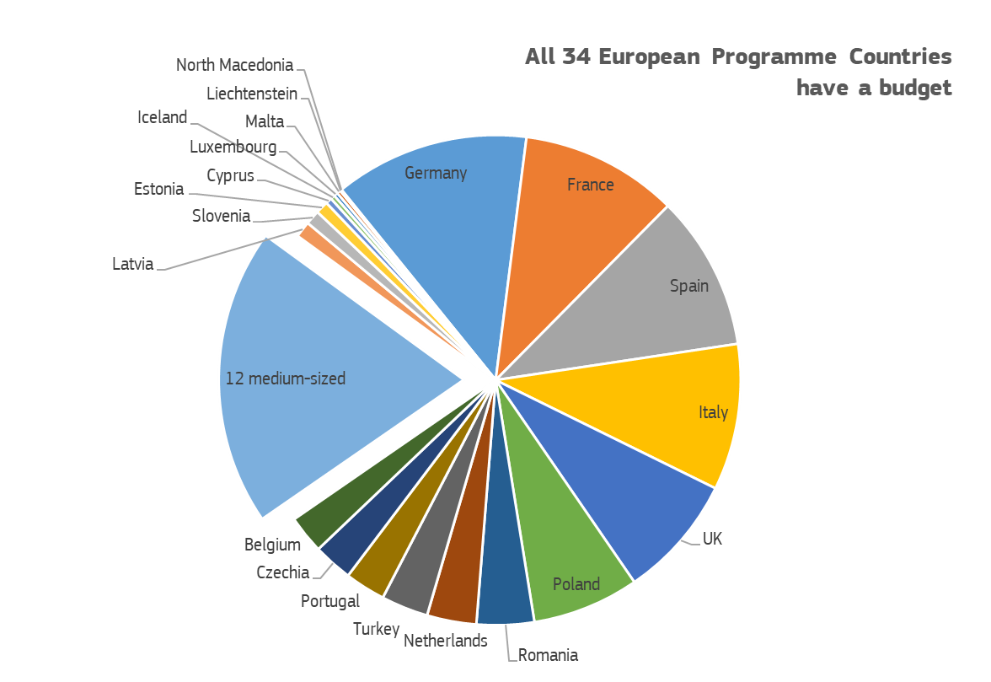
Notes:
Please also refer to the Quick Reference Guide for Partner Country HEIs.
The initiative comes from the Programme Country institutions. This means you cannot apply – you have to have a European partner to work with. We’ll look a bit later at partner search
What is importatn is that you can show that you are ready to take part in ICM.
What does this mean?
You have to be eligible: you have to be accredited by your national accreditation agency.
You also have to be fir for purpose. In Europe where we have had Erasmus exchange for 32 years, we have a special charter that is awarded to any European education establishment that meets certain standards in the education it provides and the way it organises it.
You’re not from a Programme Country you can’t have a ECHE. So
You sign up to these standards and operational requirements in the agreement that you sign with the European university.
Mobility
Clearly defined credits
Recognition of credits from other universities

Slide 11
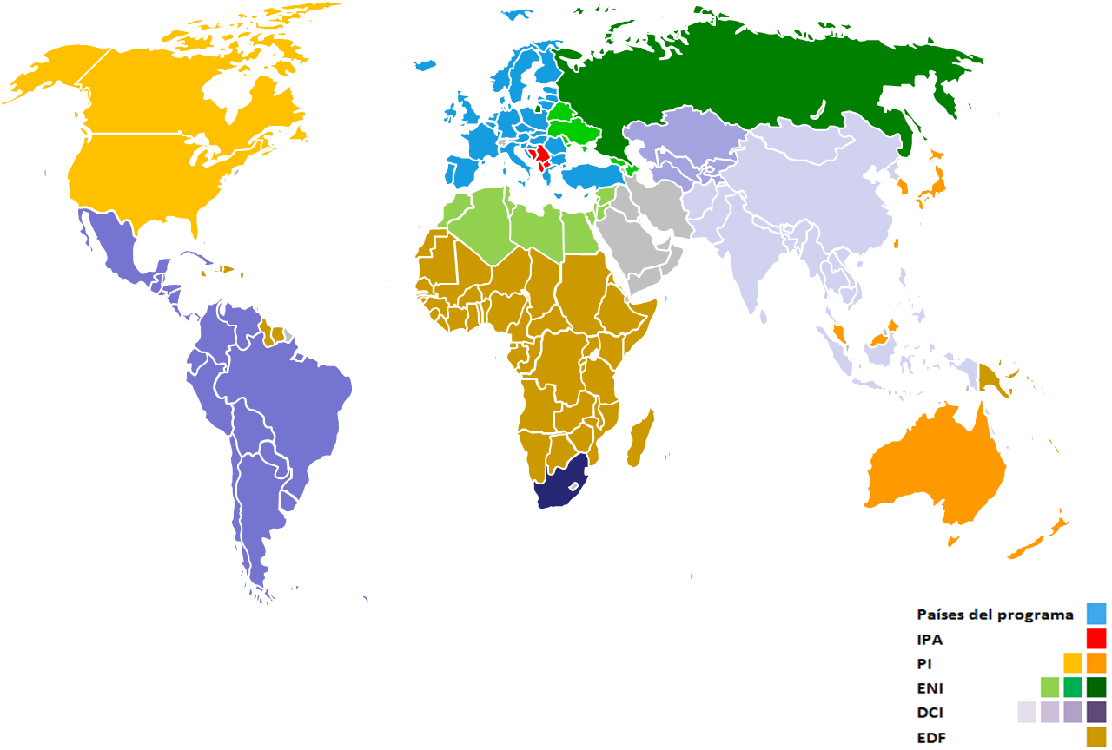
A global action

Slide 12
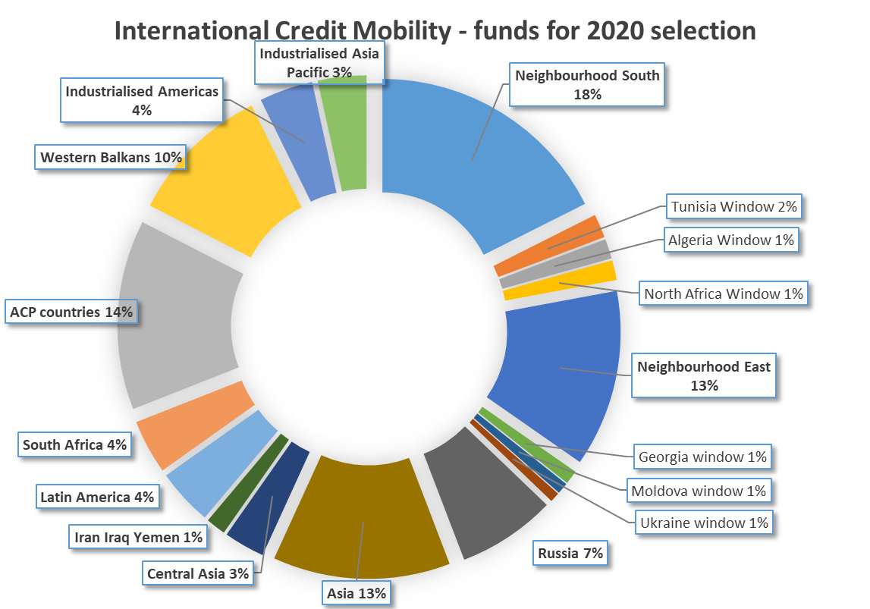
EUR 178 million
Notes:
Each Programme Country gets a budget that it divides up into this shape. So bear this in mind
Each European programme country has a budget to fund its country's agreements with partner countries worldwide.
Budgets per region are different.
Each year a call for proposals selects new mobility projects with the above budget. Each year the projects together will result in about 35,000 mobilities in each direction.
Universities in partner countries: Make use of existing contacts you have with European universities at institutional level, or within your faculties. You could use these contacts to propose an Erasmus+ mobility agreement.
Each European programme country has a budget structured in this way, so all 34 programme countries can fund mobility between their universities and universities in all the regions. Note "Middle East" on this chart = Iran-Iraq-Yemen.
Don't just think about student mobility – the staff scholarships can be very interesting for your universities to host or send academics to share new knoweldge and techniques. Admininstrative staff can move too – often useful as a first step to set new agreements on track.
The 2020 budget will be broadly similar to the previous call's budget in terms of the number of envelopes. You will see a big increase in funding for the ACP region, In addition to 12 discrete budget envelopes covering each region of the world, the European Commission is providing additional funding for a number of priority countries. National Agencies will be able to opt-in for a share of the following budget 'windows':
Tunisia
Georgia
Moldova
Ukraine
See the What's new document

Slide 13
Over 200,000 exchanges planned since 2015

Slide 14
Getting involved
Notes:
Please also refer to the Quick Reference Guide for Partner Country HEIs.

Slide 15
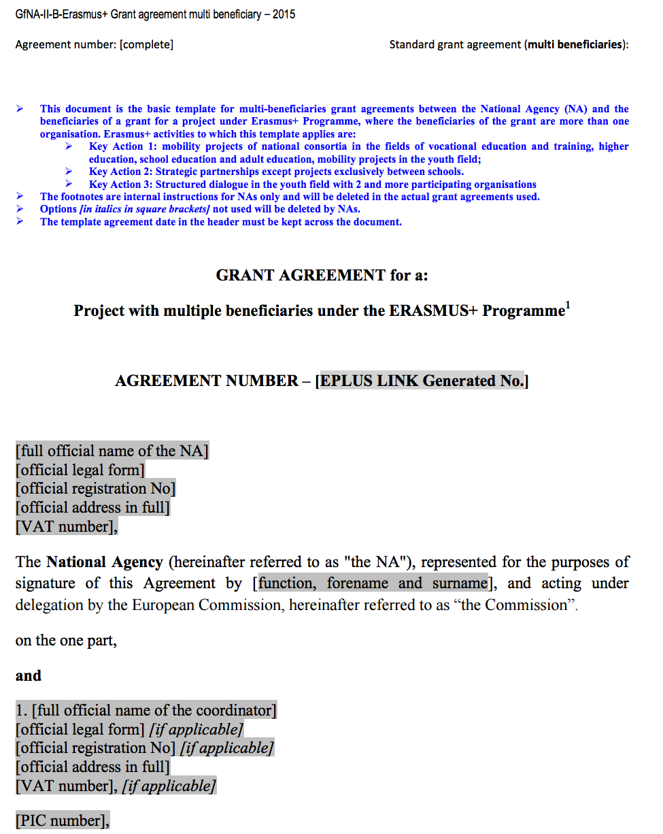
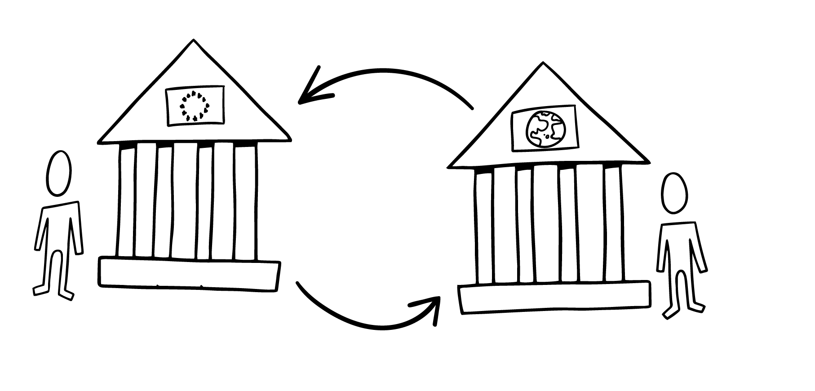
Notes:
Programme Country HEI has applied and received notification that project is selected.
They sign grant agreement with the NA: Beneficiary Grant Agreement, which provides the financial support for the project
As a partner organisation, you are not a direct party to this agreement, although your project is covered within it
This means Programme Country HEI is solely responsible for the grant, which is why it will be responsible for signing all grant agreements with the participant.

Slide 16
Notes:
By signing an inter-institutional agreement, the institutions commit themselves to respecting the principles and quality requirements of the Erasmus Charter for Higher Education (ECHE) relating to the organisation and management of mobility, and agree on a series of measures to ensure high quality mobility.
The sending institution is responsible for selecting participants and providing them with all necessary support including pre-departure preparation, monitoring during mobility, and formally recognising the mobility period. The receiving institution offers participants a study programme, or a programme of staff training or teaching activities at their institution. The inter-institutional agreement details the obligations of each institution.

Slide 17
Organisational support
EUR 350/participant
Individual support
EUR 700-900/month for students and EUR 140-180/day for staff
Contribution to travel costs
EUR 20-1500, depending on distance travelled
Notes:
Prog HEI will receive the entire OS grant, which you can agree to share between partners in the IIA. We strongly encourage including it in the Inter-Institutional Agreement.

Slide 18
Living costs
Mobility to… | Student monthly rate (2018-2020) | Staff daily rate (2018-2020)
DK, FI, IS, IE, LI, LU, NO, SE, UK | € 900 | € 180
AT, BE, CY, FR, DE, GR, IT, MT, NL, PT, ES | € 850 | € 160
BG, HR, CZ, EE, MK, HU, LV, LT, PL, RO, SK, SI, TR | € 800 | € 140
All Partner Countries | € 700 | € 180
Notes:
LIVING AND TRAVEL
Now we have the same categories for students and staff. Also some re-aligning of countries between categories, all costs increased.
Distance – more for far travel > 8000 km is now EUR 1500, travel of less than 100km also covered, but only EUR 20.

Slide 19
Travel costs | EUR per participant
< 100km | € 20
100 - 499 | € 180
500 - 1999 | € 275
2000 - 2999 | € 360
3000 – 3999 | € 530
4000 – 7999 | € 820
> 8000 | € 1500
Notes:
LIVING AND TRAVEL
Now we have the same categories for students and staff. Also some re-aligning of countries between categories, all costs increased.
Distance – more for far travel > 8000 km is now EUR 1500, travel of less than 100km also covered, but only EUR 20.

Slide 20
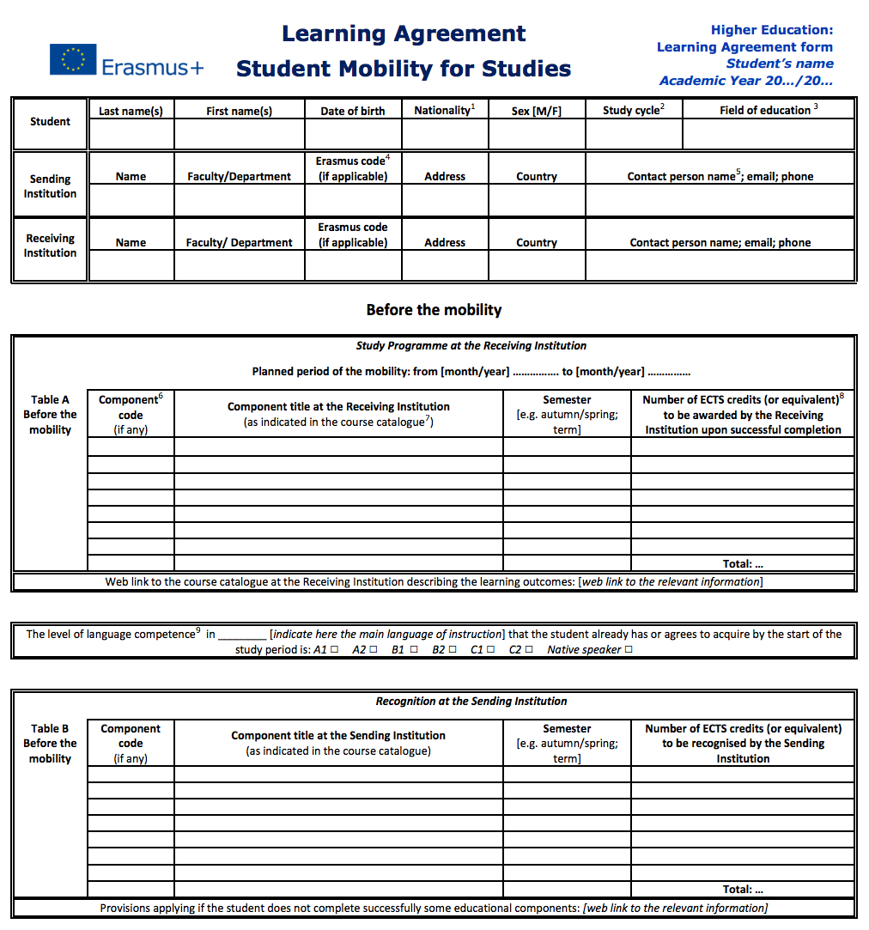
Notes:
Before the mobility can start, the sending and receiving institutions, together with the participant (student or staff), must agree on the activities that the participant will undertake during the period abroad.
The learning agreement sets out the study programme to be followed by the student, defines the target learning outcomes and specifies the formal recognition provisions. For more detailed information, please refer to these 'Guidelines on how to use the learning agreement for studies'.
Similarly, the mobility agreement for members of staff sets out the teaching or training programme to be followed, and lists the rights and obligations of each party.

Slide 21
Application form: qualitative assessment
Notes:
Important difference with intra-european mobility
Development money
Relevance for regions (both sides)
These are projects

Slide 22
International Credit Mobility Timeline for Contractual Documents
European Commission
Start of the mobility projects
(1 August)
Delegation Agreement
National Agency
Qualitative Assessment
Every month, once mobilities have started
Reporting to National Agency
Interim report & final beneficiary report
Application Form
2 February 2016
Grant Agreement
Programme Country HEI
Before the start of the actual mobility
ECHE
Reporting in Mobility Tool+
PIC
Inter-institutional Agreement
Before encoding mobilities in Mobility Tool+
Partner Country HEI
Learning/ Mobility Agreement
3 parties
+
Grant Agreement
Programme HEI-Participant
Before the start of the actual mobility
PIC
Students: 30 days before the end of the mobility
Staff: After the end of the mobility
Participants
After the end of the mobility
Participant Report
Online EU Survey
Student Survey on Recognition
Application Phase
Contractualisation Phase
Implementation & Reporting Phase
Notes:
All projects will start on 1 August and last 24 or 36 months. This will allow to not lose the last semester (until now projects would end on 31 May).

Slide 23
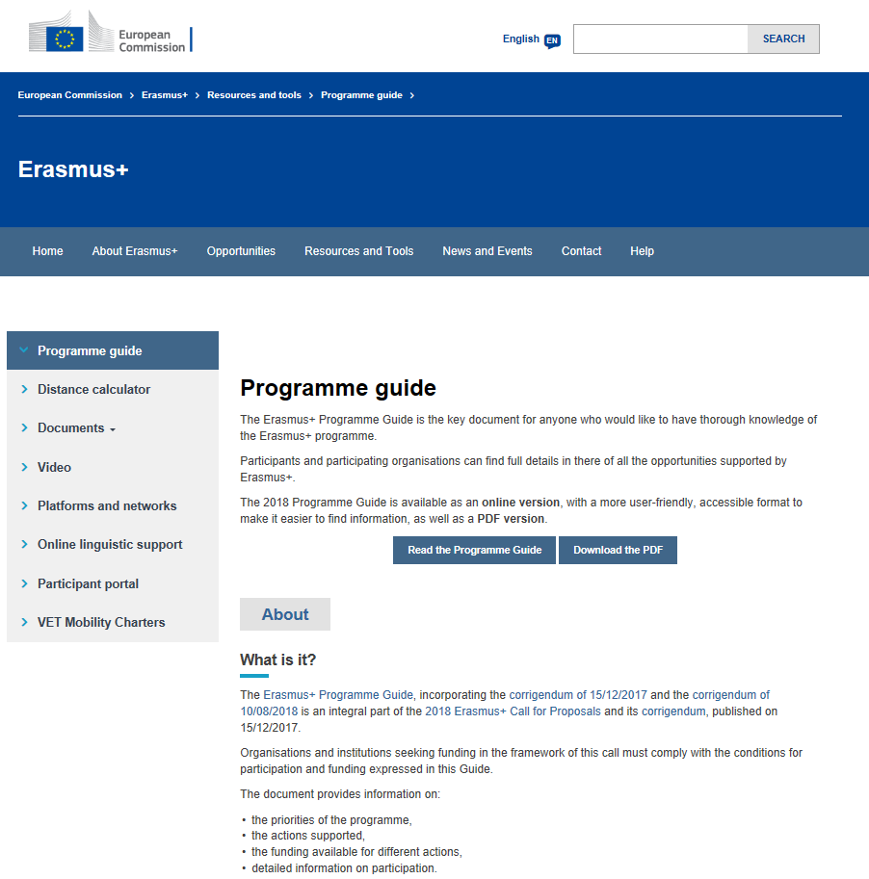
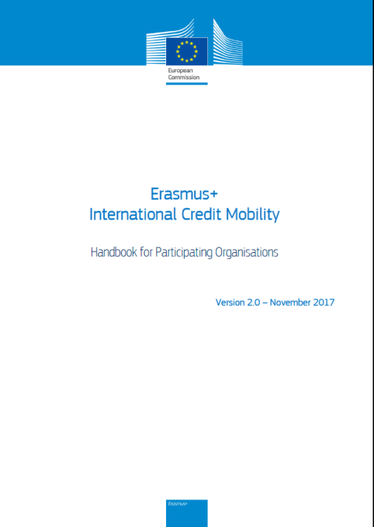
More guidance and detail?
Erasmus+ Programme Guide online (all EU languages)
ICM handbook
Notes:
In addition to the Programme Guide, we have produced a series of guidelines to help you understand the action.

Slide 24
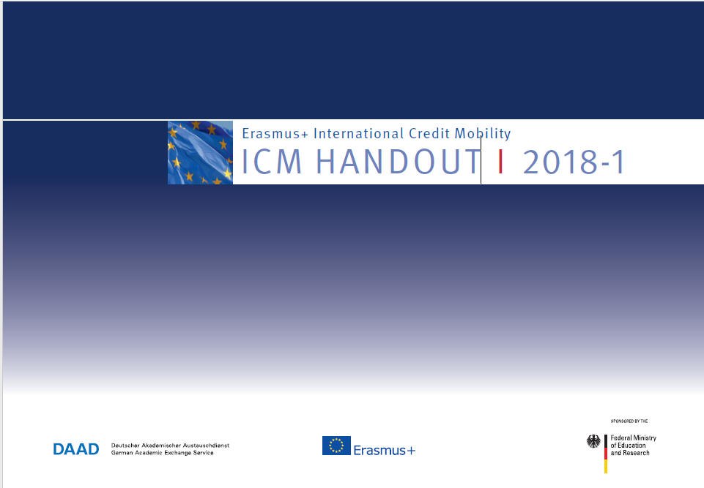
More guidance and detail?
Handout "from colleagues for colleagues"
Written by practitioners
Specially designed for Partner Country universities wishing to start ICM projects
At the initiative of the German Academic Exchange Service
https://eu.daad.de/eudownloadcenter/download/536/

